Slide 1
JSP Pagination

Slide 2
JSP Pagination
In this module we will see below topics
JSP Pagination
JSP Pagination Example

Slide 3
JSP Pagination
Pagination is a concept or rather a technique to divide the result set into smaller byte size pages for the user to browse through with ease. Pagination by definition is a process to divide content into discreet pages.
Before the progress of Information Technology, pagination was entirely a manual process and print layout was the sole intention. But in today’s world pagination is done mainly to enhance the speed of data fetching in a certain website. Fetching all the data at a time is a slow and resource intensive job, also the user who has to view through the entire list has a poor experience due to amount of data he has to scroll through. Well designed websites always take care of these issues and provide a user friendly experience.
Pagination can be used in server side and client side. Server side pagination is used when
Faster initial page loading is required
Complex business logic is required in view part
There are large data sets
Client side pagination is used when:
The data set is small
Subsequent page load is faster
Full support for sorting and filtering

Slide 4
JSP Pagination Example Duration :40 min
In this pagination example, we are using MySQL database to fetch records.
We have created “ProdInfo" table in "test" database. The ProdInfo table has three fields: prname, prid and quabtity. create table and insert records manually..
CREATE TABLE `ProdInfo` ( `pr_name` varchar(20)not null, `pr_id` int(3)not null, `quantity` varchar(10) ) ENGINE=InnoDB DEFAULT CHARSET=latin1;
For inserting into table
insert into ProdInfo values('T-Shirt',561,60);
insert into ProdInfo values('Soap',111,'30');insert into ProdInfo values('Brush',23,'3');insert into ProdInfo values('Chair',123,'35');insert into ProdInfo values('Books',781,50);insert into ProdInfo values('Coffee',17,'33')insert into ProdInfo values('T-Shirt',561,'60);

Slide 5
JSP Pagination Example Duration :40 min
index.jsp
<a href="view.jsp?page=1">View Employees</a>
view.jsp
<%@ page import="java.util.*,com.test.dao.*,com.test.beans.*" %>
<%
String spageid=request.getParameter("page");
int pageid=Integer.parseInt(spageid);
int total=5;
if(pageid==1){}
else{
pageid=pageid-1;
pageid=pageid*total+1;
}
List<Emp> list=EmpDao.getRecords(pageid,total);
out.print("<h1>Page No: "+spageid+"</h1>");
out.print("<table border='1' cellpadding='4' width='60%'>");
out.print("<tr><th>Id</th><th>Name</th><th>Salary</th>");
for(Emp e:list){
out.print("<tr><td>"+e.getId()+"</td><td>"+e.getName()+"</td>
<td>"+e.getSalary()+"</td></tr>");
}
out.print("</table>"); %>
<a href="view.jsp?page=1">1</a>
<a href="view.jsp?page=2">2</a>
<a href="view.jsp?page=3">3</a>
package com.test.model;
public class Product {
private String prname;
private int prid;
private String quantity;
public void setPrname(String prname) {
this.prname = prname;
}
public String getPrname() {
return prname;
}
public void setPrid(int prid) {
this.prid = prid;
}
public int getPrid() {
return prid;
}
public void setQuantity(String string) {
this.quantity = string;
}
public String getQuantity() {
return quantity;
}
}
package com.test.dao;
import java.sql.Connection;
import java.sql.DriverManager;
import java.sql.PreparedStatement;
import java.sql.ResultSet;
import java.util.ArrayList;
import java.util.List;
import com.test.model.Product;
public class ProdDao {
public static Connection getConnection(){
Connection con=null;
try{
Class.forName("com.mysql.jdbc.Driver");
con=DriverManager.getConnection("jdbc:mysql://localhost:3306/test","root","root");
}catch(Exception e){System.out.println(e);}
return con;
}

Slide 6
JSP Pagination Example Duration :40 min
public static List<Product> getRecords(int start,int sum){
List<Product> list=new ArrayList<Product>();
try{
Connection con=getConnection();
PreparedStatement ps=con.prepareStatement(
"select * from ProdInfo limit "+(start-1)+","+sum);
ResultSet rs=ps.executeQuery();
while(rs.next()){
Product p=new Product();
p.setPrname(rs.getString(1));
p.setPrid(rs.getInt(2));
p.setQuantity(rs.getString(3));
list.add(p);
}
con.close();
}catch(Exception e){System.out.println(e);}
return list;
}
}

Slide 7
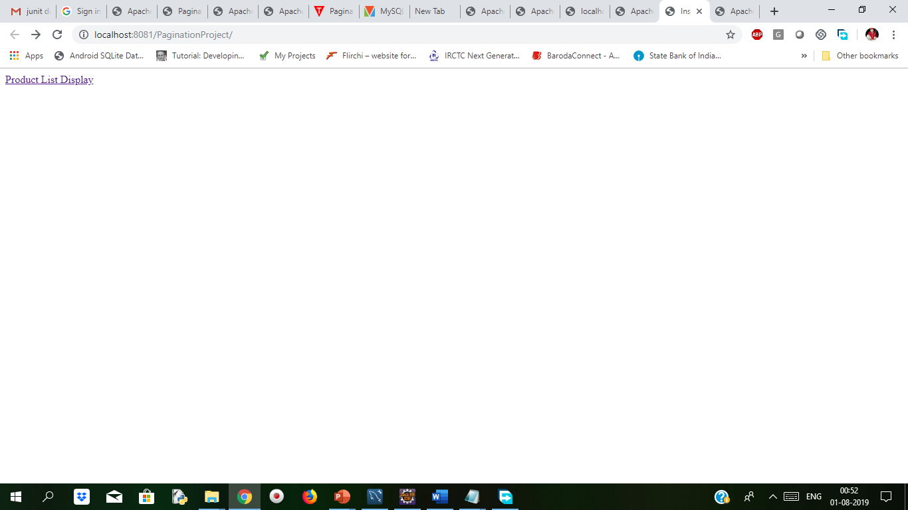
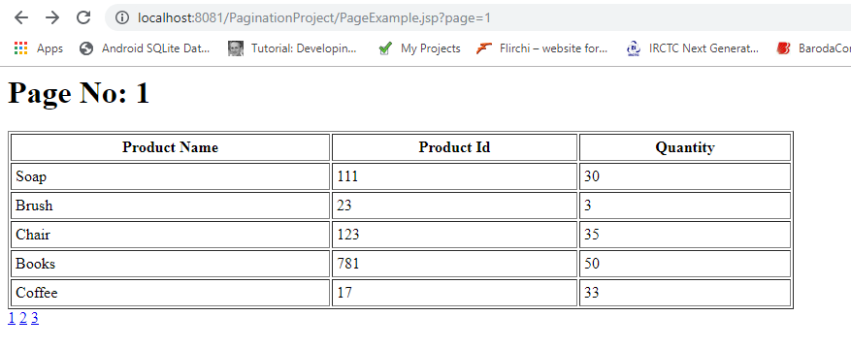
JSP Pagination Example Duration :40 min
Output
Notes:
In this way we are fetching the records from database with the using pagination

Slide 8

Thank You

